Slide 1
CMOS Particle Energy Detection
Presented by Logan Horner and Hayden West
EagleSat 2 Science Team
Mentor: Dr. Sulyman
Special Thanks to Dr. Smith
April 8th, 2021

Slide 2
EagleSat 2
EagleSat 2 is the CubeSat program that develops cube like satellites to be deployed into space off the International Space Station(ISS).
This is the second cube satellite and has two main experiments a Memory Degradation Experiment (MDE), and the Cosmic Ray Payload (CRP).

Slide 3
The Idea
The objective of this research is to determine what is the correlation between pixel intensity and particle energies
The particle detection by the sensor leaves a distribution of charge across multiple pixels

Slide 4
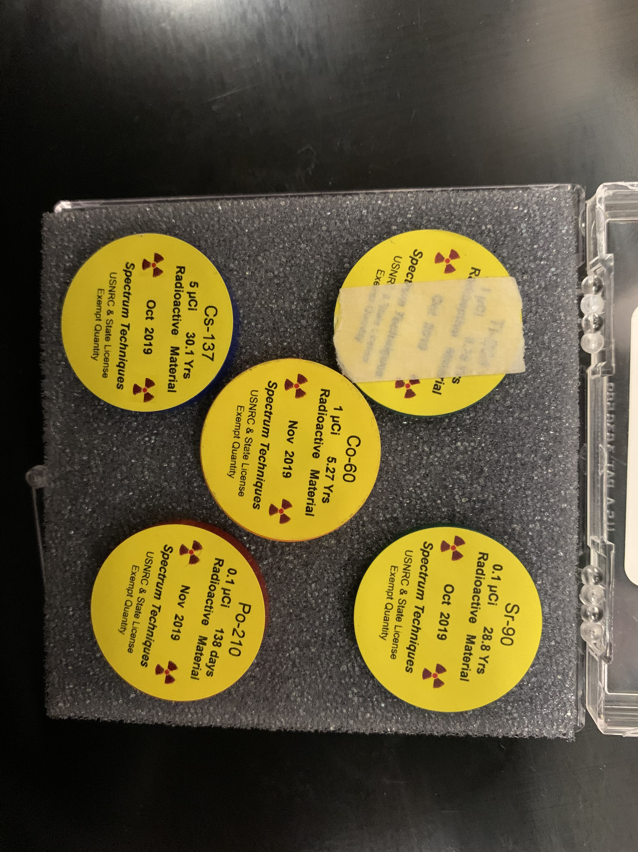
How?
The sensor that we are using to detect these particles is called a Complementary Metal Oxide Semiconductor (CMOS)
The particle detection will be done and conducted with several different radiation sources

Slide 5
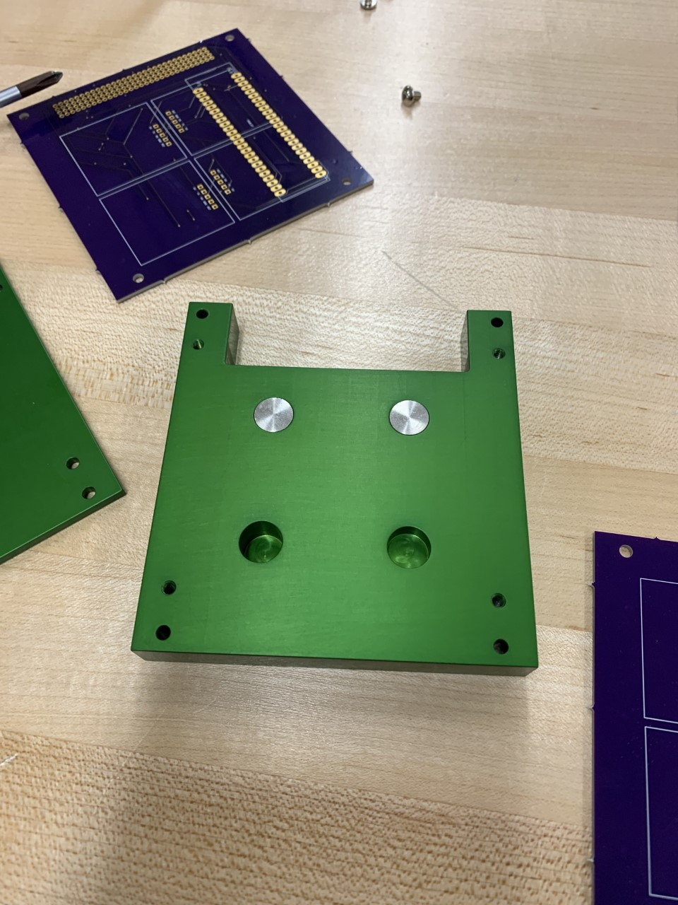
Done So Far
The digital circuits logic has been done by another member on EagleSat 2 named Trevor Butcher.
The setup for the experimental portion of the testing is done and the code for generation of pictures is done in Python.
The Bethe-Bloch equation has been programmed with an output.
April 8th, 2021

Slide 6
Application
The most immediate use of this application is to allow for the CRP payload to more accurately describe particle energies on EagleSat 2.
The other most useful application is the ability to understand the way in which particles may act with any new EagleSat 2.

Slide 7
Future
Geant4
Experiment
This is a Monte Carlo simulation software.
The software simulates how particles move through different materials.
The goal is to use this software to simulate interactions on the CMOS sensor.
The experiment will be used to confirm this data from the simulation software.
The experimentation will then be used to further write analysis code and understanding
Babbsack. “DAGATA-Detektor Monte Carlo Simulation with Geant4.Png.” Geant4, Wikipedia, 16 July 2008, commons.wikimedia.org/wiki/File:DAGATA-Detektor_Monte_Carlo_Simulation_with_Geant4.png.
April 8th, 2021

Slide 8
Thank You
Hayden West
EagleSat 2 Science member
westh2@my.erau.edu
Logan Horner
EagleSat 2 Science Lead
hornerl@my.erau.edu

